Slide 1
Subject: Physics for Computer Professionals
Module: Communication Channels
(F.Y.B.Tech I.T and CSE Students)
Prof.Kiran Madhale

Slide 2
Communication Channels
Communication is simply defined as the transfer of information from one place to another.
A path through which information is transferred from one place to another place is called communication channel.
It is also referred as medium or link. In communication channels, data is transmitted in the form of signals (analog or digital). Data transmission is measured in bandwidth. Bandwidth is amount of information that can be transmitted through the channel within a given period of time. For analog signals it is expressed in Hertz while for digital signals in bits per second (bps).Different communication channels have different bandwidth.

Slide 3
Types of Communication channels
1) Wired channels
2) Wireless channels

Slide 4
Wired channels
In this type of channels, communication devices are connected directly by wires or cables. The examples of wired channels are
a) Twisted pair cable
b) Coaxial cable
c) Fiber optic cable

Slide 5
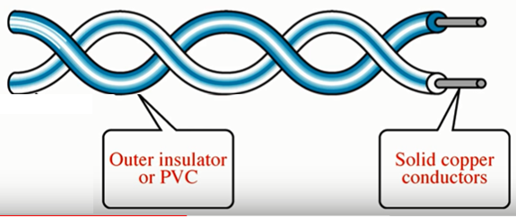
Twisted pair cable
In this type of cables, two insulated wires are twisted together. The one of the wire carry signals and other wire used as ground reference. They are twisted together because crosstalk or noise generated by adjacent pairs of wires is minimised. The number of twists per unit length determines the quality of cable. If there are more twists, cables have better quality. For example in one centimetre maximum 2 twists are there.

Slide 6
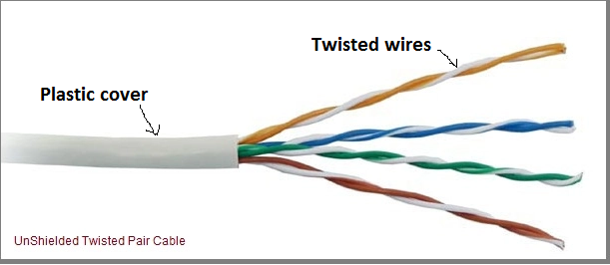
Types of twisted pair cable
1) Unshielded twisted pair cable (UTP):
In this type, wires are twisted together only

Slide 7
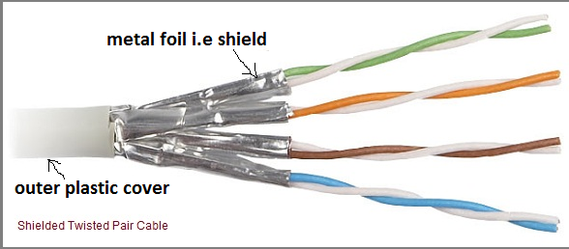
Types of twisted pair cable
Shielded twisted pair cable ( STP):
In this type of cables, an additional coating or metal foil i.e shield is provided on each set of the pair of wires. This shielding prevent the effect of crosstalk or noise.

Slide 8
Key Differences between UTP and STP Cables
UTP and STP are the types of twisted pair cable where UTP is the unshielded type whereas STP is shielded (metal foil is used).
UTP reduces the crosstalk or noise as compared to the parallel arrangement of the wires but not at great extent. On the contrary, STP decreases the crosstalk or noise significantly.
UTP cables are easily installed while installation of STP cables is difficult are the cables are bigger, heavier and stiffer.
Grounding is not required in UTP cables. As against, STP cables requires grounding.
UTP cables are inexpensive whereas STP cables are costly comparatively due to additional material and manufacturing.
STP cables carry data at high speed of rate. In contrast, UTP provides less speed of data transfer. Data rate transfer is 1 mbps without any extra device ,with extra devices data transfer rate can be increased up to 10 mbps

Slide 9
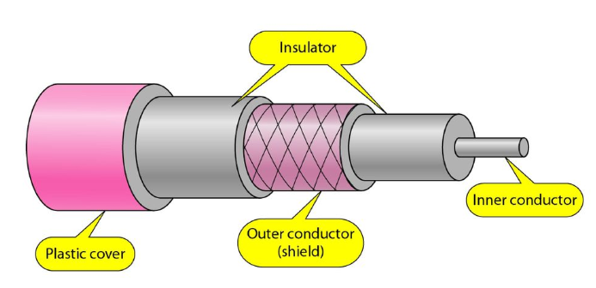
Coaxial cable
A coaxial cable consist of two conductors (inner conductor and outer conductor) separated by insulating (dielectric) material. Data is transmitted through inner conductor and second conductor acts as ground. The outer conductor is also covered by insulating material. Both the conductors are parallel and share a same (common) axis that is why this cable is named as coaxial cable. The outermost part is the plastic cover which protects the whole cable from external damage. These types of cables are suitable for high speed communication (400 mbps) and widely used in TV signals.

Slide 10
Types of coaxial cables
There two types of coaxial cables
1) Thicknet (10Base5)
2) Thinnet cable (10Base2)

Slide 11
Thicknet (10Base5)
Here
10 refer the rate data transmission i.e. 10Mbps. (Megabits per second).
Base refers baseband
5 refer the distance between computers should not more than 5 meters.
Maximum of 100 network devices are allowed.
Maximum cable length is 500 meter.
The diameter of central wire is 1.27cm.

Slide 12
Thinnet cable (10Base2)
10 refer the rate data transmission i.e. 10Mbps. (Megabits per second).
2 refer the distance between computers should not more than 2 meters.
Maximum of 30 network devices are allowed.
Maximum cable length is 185 meter.
The diameter of central wire is 0.64cm.

Slide 13
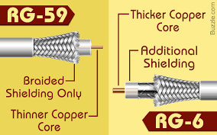
Coaxial cable
Coaxial cables are also categorised by RG (Radio Guide) number. Higher is the RG number thinner is central diameter.

Slide 14
Coaxial cable
Advantages and disadvantages of coaxial cable
Advantages:
1) Transmission is much better than twisted pair cable
2) It can be used on the basis of shared cable network.
3) High bandwidth 400 Mbps.
Disadvantages:
Very expensive as compare to twisted pair cable.
Not compatible with other cables.

Slide 15
Coaxial cable : Applications
It is used to carry television signals and connect video equipment together.
It carries radio signal and connects the receiver, transmitter and antenna together.
Short lengths of a coaxial cable are used for connecting devices with test equipment such as signal generators.
It is used for connecting computers in local area networks and is widely used in cable broadband.
RG-59 coaxial cable is the best type for CCTV systems. RG-6 is better for digital video signals

Slide 16
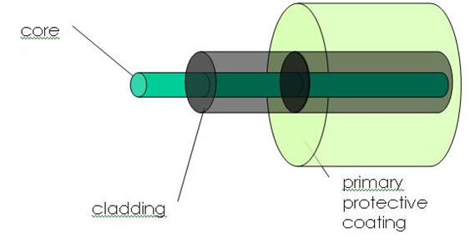
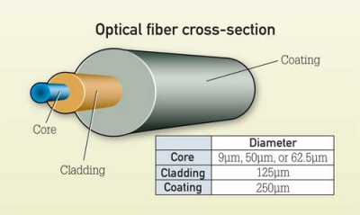
Optical Fiber Structure

Slide 17
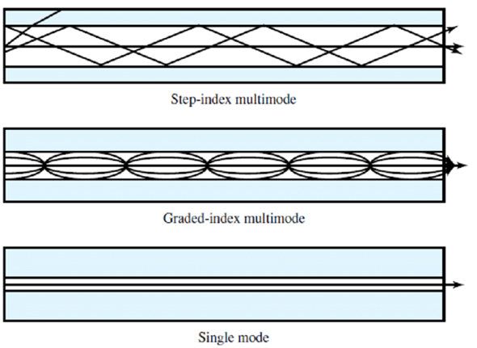
Types of Optical fiber

Slide 18
Notes of remaining part of this module will be given very soon.
Stay Home Stay Safe Take Care

